Slide 1
Get Energised!
Scotland’s environment

Slide 3
"Scotland Southern Uplands01 2002-08-16". Licensed under Creative Commons Attribution-Share Alike 3.0 via Wikimedia Commons - http://commons.wikimedia.org/wiki/File:Scotland_Southern_Uplands01_2002-08-16.jpg#mediaviewer/File:Scotland_Southern_Uplands01_2002-08-16.jpg

Slide 6
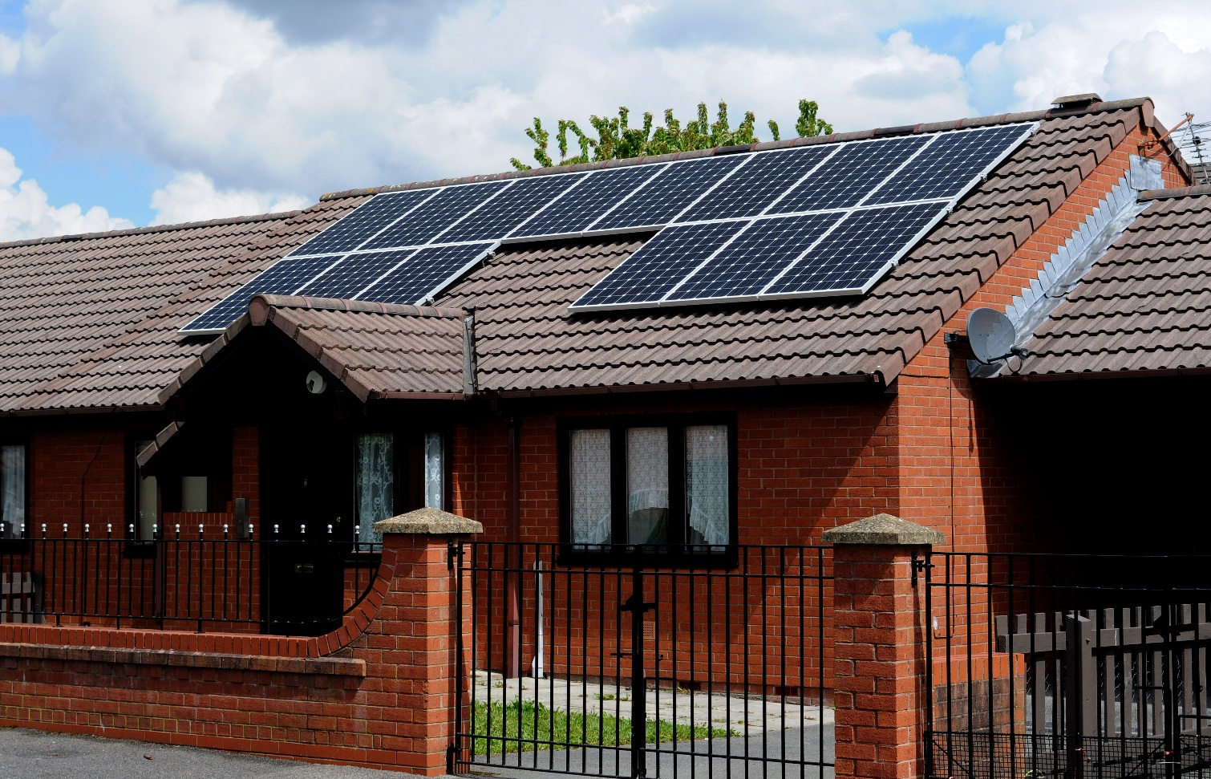
Solar Power
Image courtesy of SP Energy Networks
Notes:
When it isn’t raining Scotland does have a lot of daylight, especially in the summer months. The longest day can have over 18 hours of daylight but in the winter the shortest day is around 6 hours. This means that in the summer months there is lots of time available for solar panels to be used to generate electricity. However, the output of the solar panels do depend on the weather. If it is cloudy or raining then the amount of electricity generated will be less than if it was a clear sky.

Slide 7
Hydro Power

Slide 8
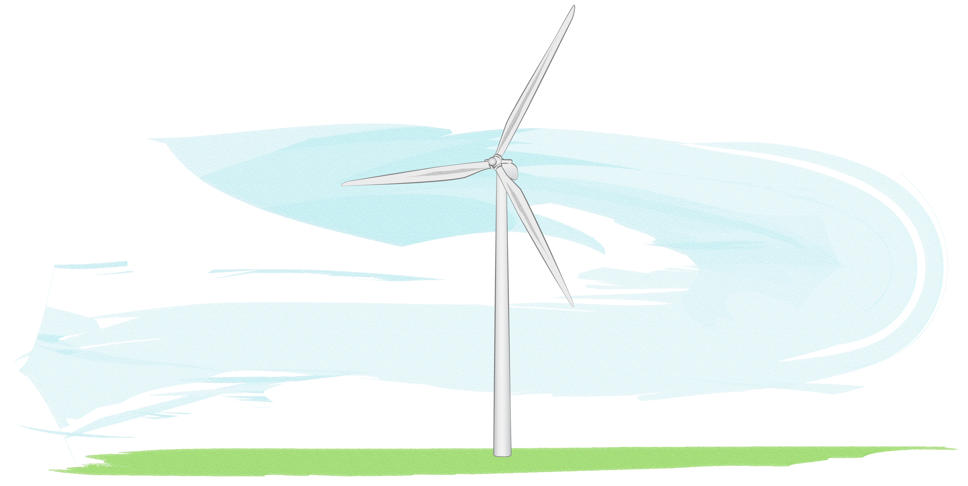
Wind Power

Slide 10
Task

Slide 11
Results

