Slide 1
Get Energised!
Engineering in Scotland

Slide 2
What is Engineering?

Slide 3
Finding a solution

Slide 4
Famine at en.wikipedia

Slide 5
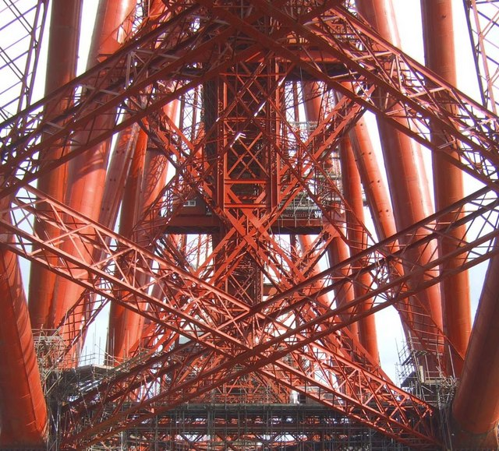
Simon Johnston
Network Rail

Slide 6
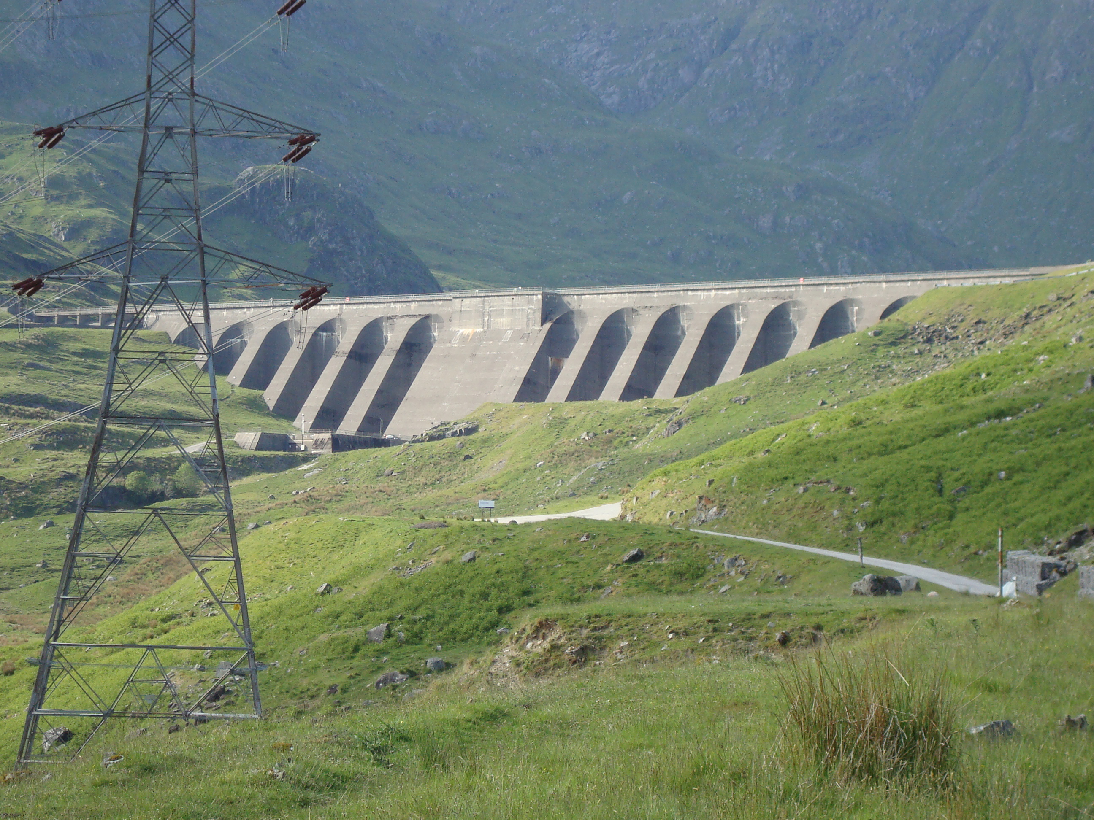
Raining girl at en.wikipedia

Slide 7
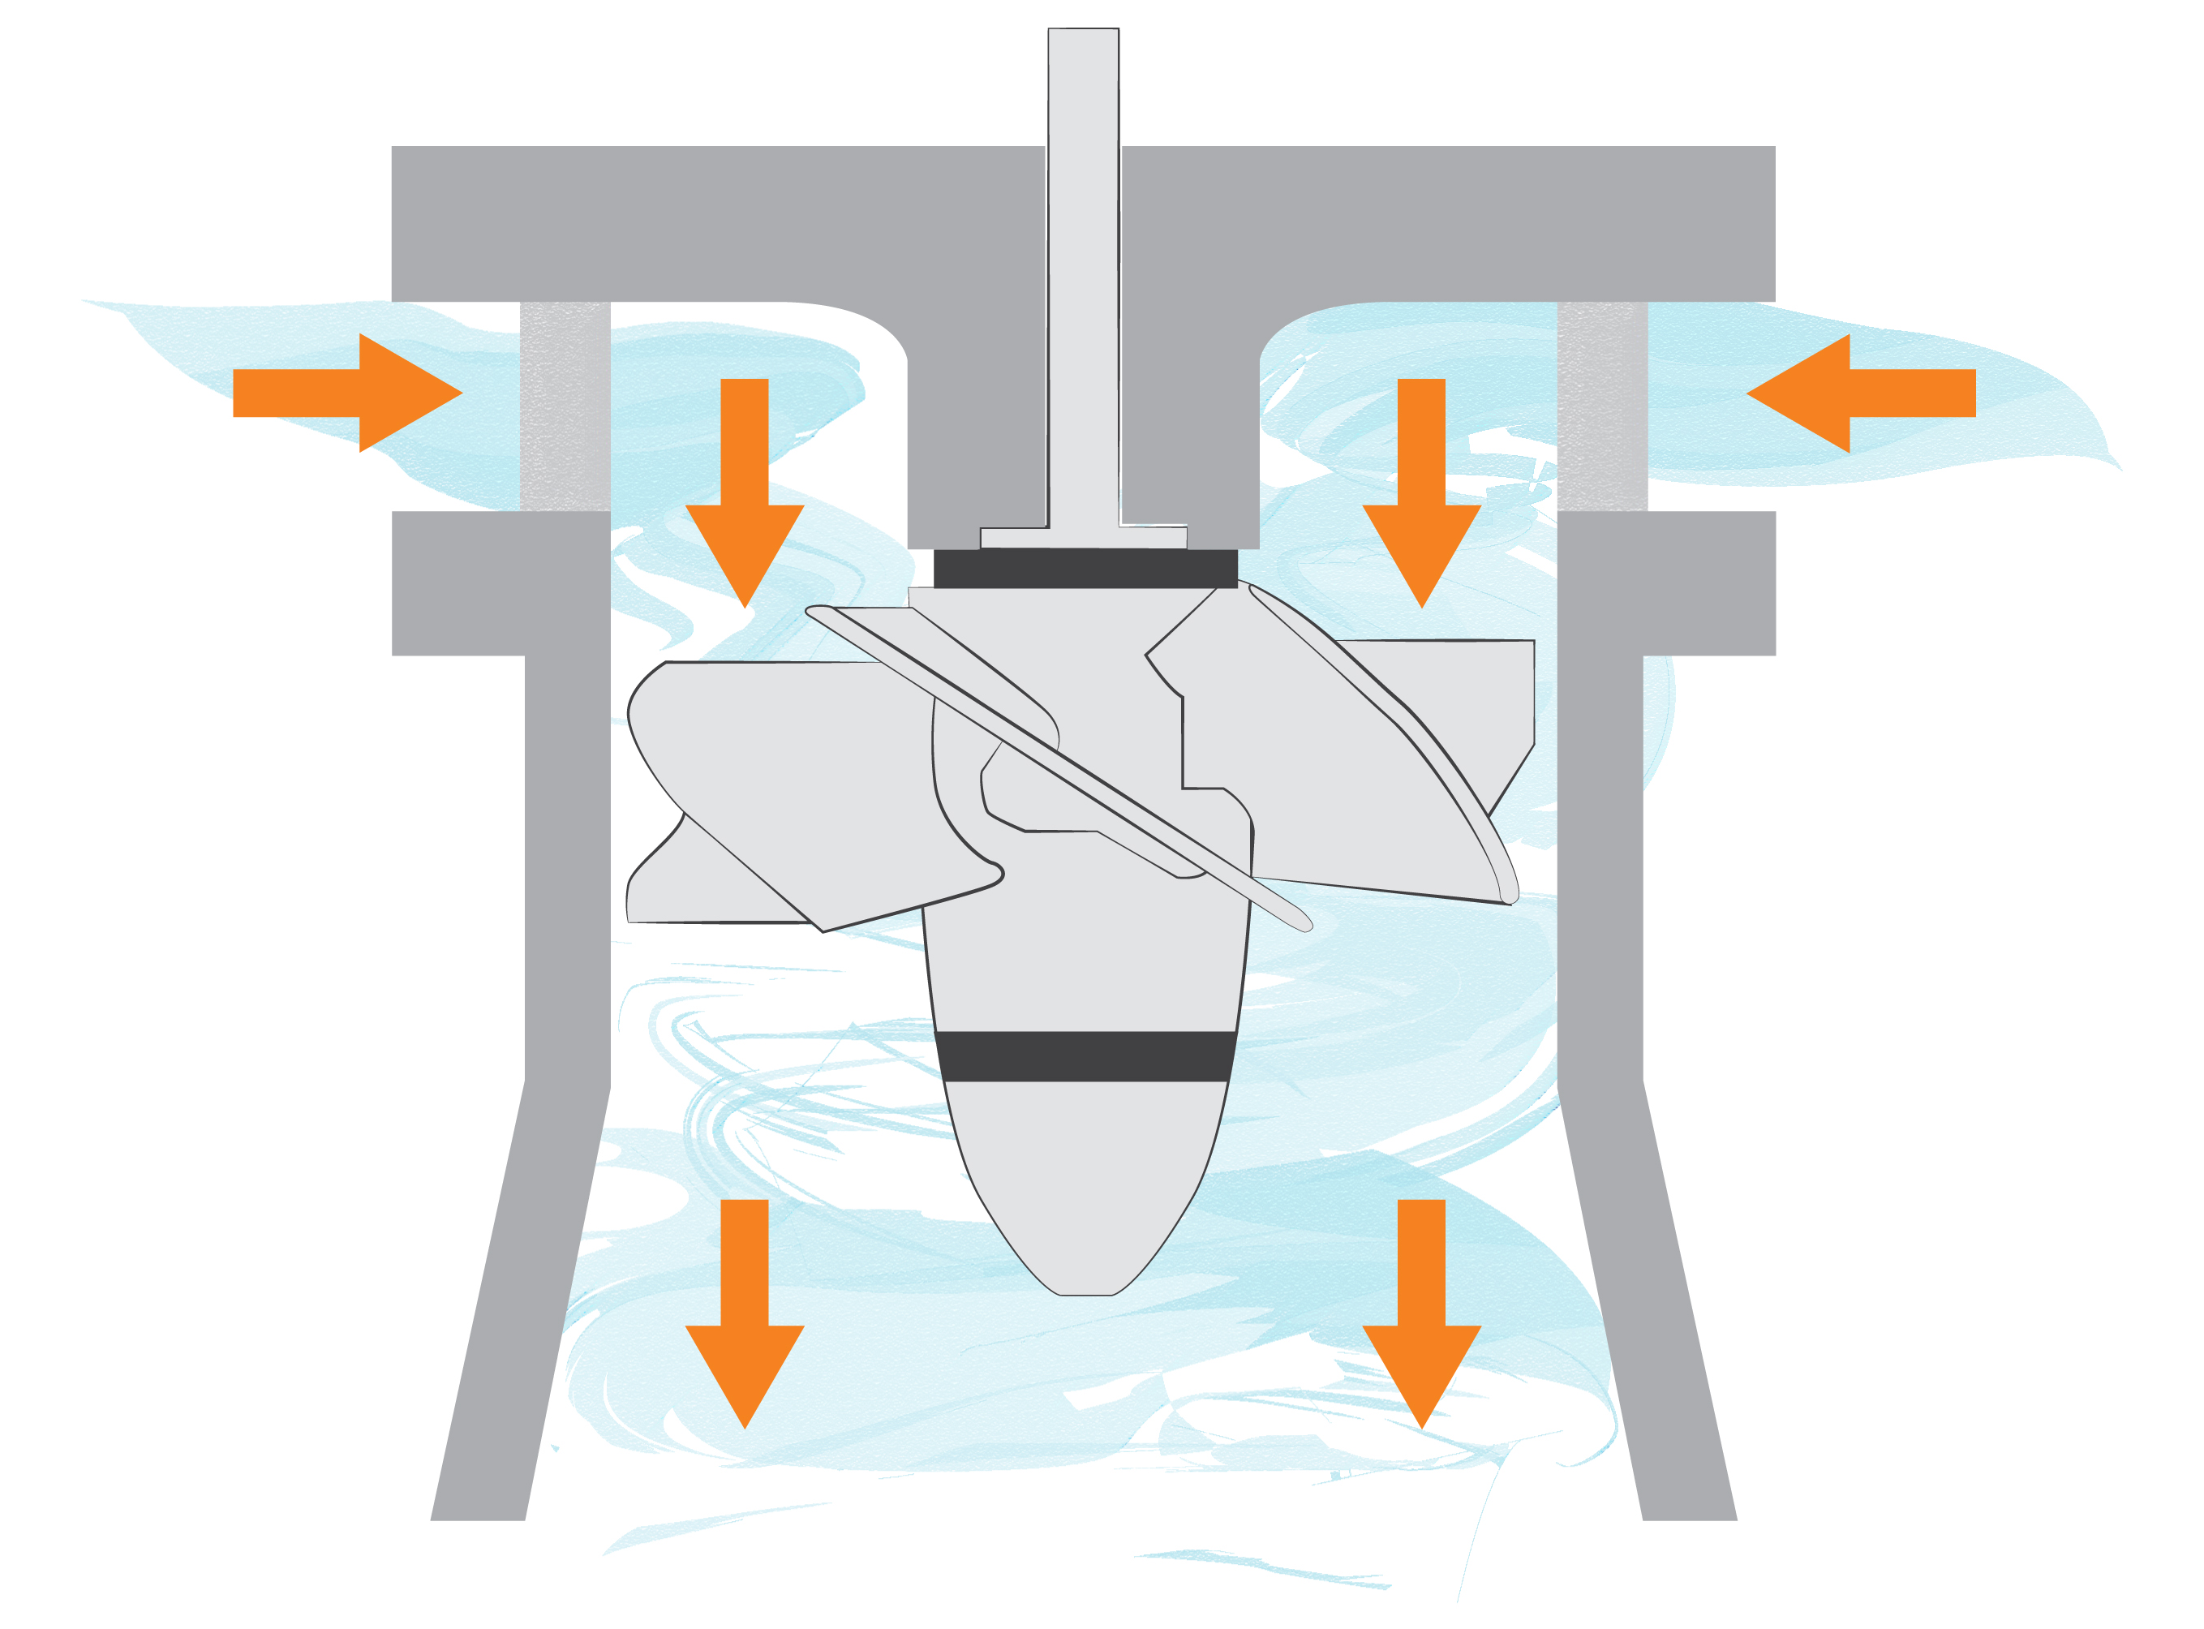

Slide 9
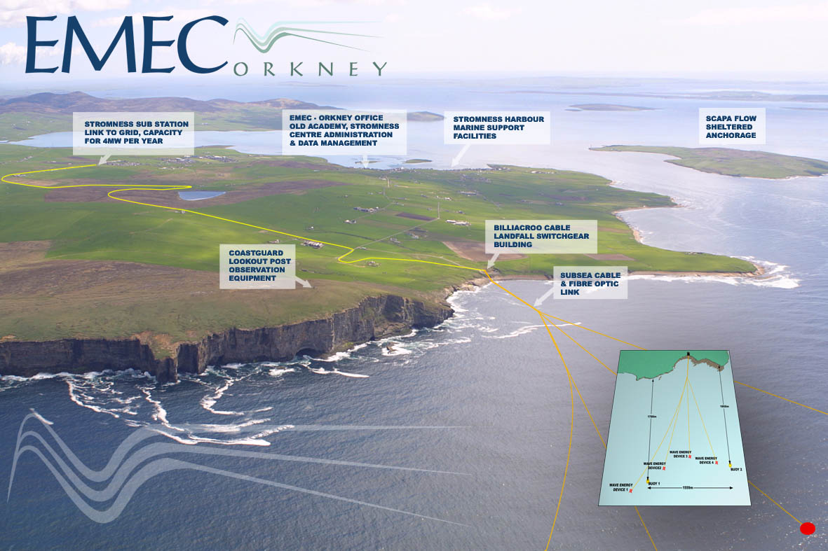
The European Marine Energy Centre (EMEC) in Orkney is a place where new technologies across tidal and wave power can be tested.
© EMEC

Slide 10
Your Challenge

Slide 11
Results

