Slide 1
Sunny Spells and Solar Storms:
understanding space weather with LUCID

Slide 2
Earth
Image credit: NASA

Slide 3
The Sun
Image credit: SOHO (ESA & NASA)

Slide 4
The Earth’s magnet:
Image credit: Amanda Hayward

Slide 5
The Sun’s magnet:
Image credit: Amanda Hayward

Slide 6
The solar wind:
Image credit: SOHO (ESA & NASA)

Slide 7
Coronal mass ejection (CME):
Image credit: SOHO (ESA & NASA)

Slide 8
Solar flare:
Image credit: SOHO (ESA & NASA)

Slide 9
Aurora Borealis/Northern Lights:
Image credit: US Air Force

Slide 10
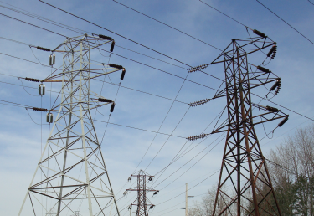
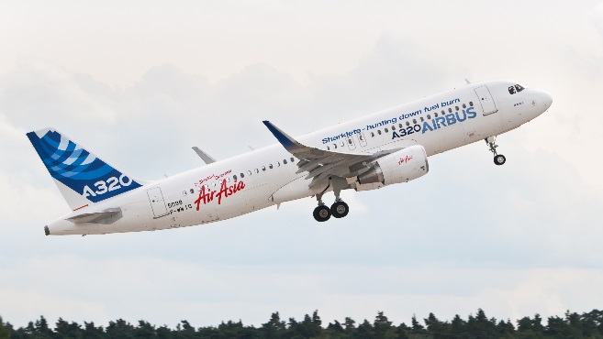
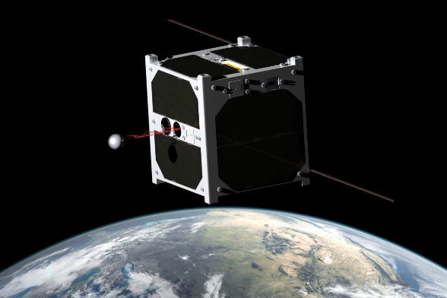
Effects of space weather:
Image credit: Truthando
Image credit: Julian Herzog
Image credit: NASA
Image credit: University of Tartu, ESTCUBE team

