Slide 1
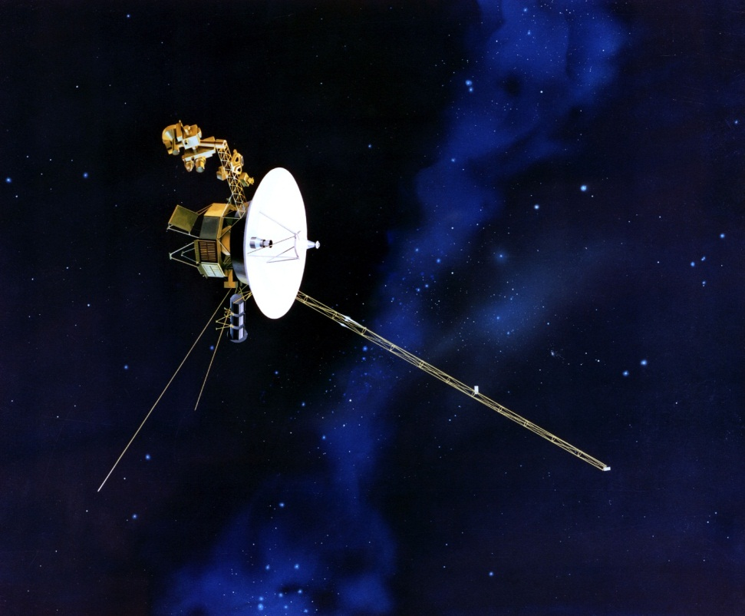
Voyager 1
Size | 721.9 kg
Signal time | 17 hours
Target | Jupiter, Saturn, Uranus, Neptune
Mission duration | 34 years (in progress)
Distance from us | 1020 light minutes
NASA/JPL

Slide 2
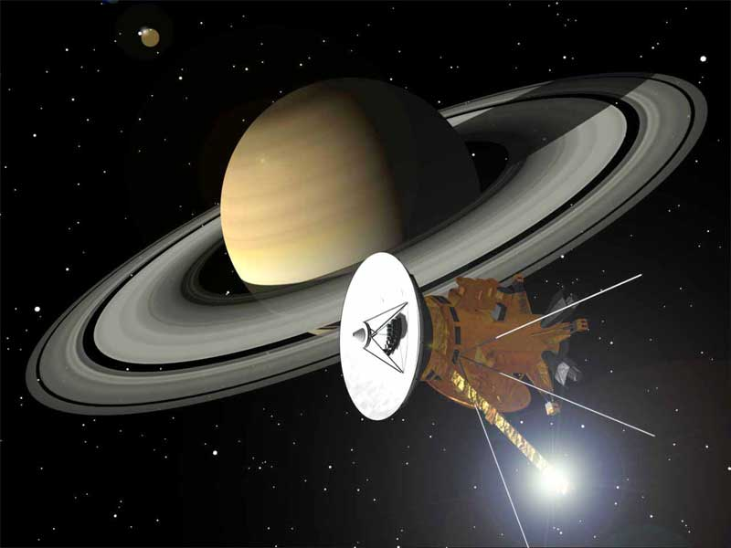
Cassini-Huygens
Size | 2523 kg
Signal time | 68 minutes
Target | Saturn
Mission duration | 9 years (in progress)
Distance from us | 68 light minutes
NASA/JPL

Slide 3
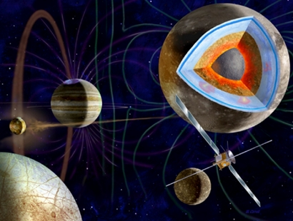
JUICE
Size | Not yet built
Signal time | 30 minutes
Target | Jupiter and its moons
Mission duration | Launch 2022 Arrive 2030
Distance from us | 30 light mintes

