Slide 1
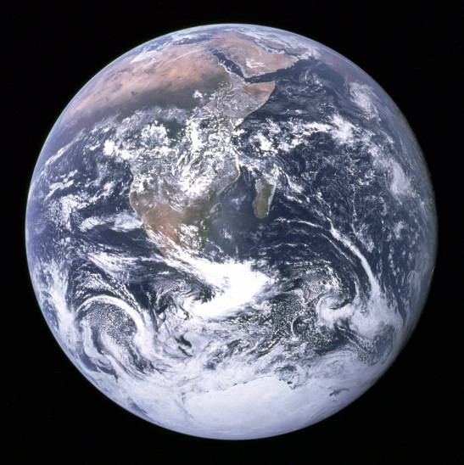

Slide 4
What falling looks like…

